Slide 1
Monitoring and tuning .Net Applications
Day 3 - Chapter 2

Slide 2
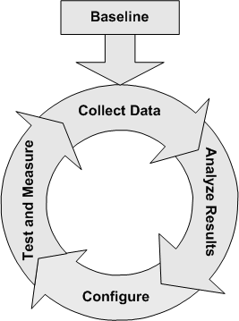
Monitoring and Tuning
Performance improvement is a continuous process

Slide 3
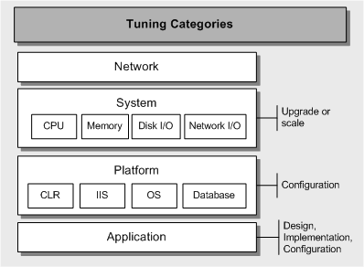
Monitoring and Tuning
Several categories to improve performance, need to find “hot spot” for top performance improvement

Slide 4
Monitoring and Tuning
System Tuning
CPU
Processor - % Processor Time
Processor - % Privileged Time
System - Processor Queue Length
System - Context Switches/sec
Keep a watch on
Processor\ % Processor Time often exceeding the 75% threshold.
Analyze and tune the application that is causing the high CPU utilization
A sustained queue of 2 for a prolonged period indicated by System\ Processor Queue Length.
Add multiple processors if you have multi-threaded applications. Consider
Upgrading to a more powerful processor if your application is single-threaded.
Unusually high values for Processor\ % Privileged Time or System\Context Switches/sec.
consider reducing the thread count for your process before increasing the number of processors

Slide 5
Monitoring and Tuning
System Tuning
Memory
Memory - Available Mbytes
Memory - Page Reads/sec
Memory - Pages/sec
Memory - Cache Bytes
Memory - Cache Faults/sec
Server - Pool Nonpaged Failures
Server - Pool Nonpaged Peak
Cache - MDL Read Hits %
Keep a watch on
Monitor each process object's working set counter. If Available MBytes remains high even when the process is not active, it might indicate that the object is not releasing memory.
Use the CLR Profiler tool at this point to identify the source of any memory allocation problems
Turn off services you do not use and Remove unnecessary protocols and drivers.
Page File Optimization: Increase the page file size on the system to 1.5 times the size of physical memory available, but only to a maximum of 4,095 MB.
Page File Optimization: Make sure that the page file is not fragmented on a given partition.
Page File Optimization: Separate the data files and the page file to different disks only if the disk is a bottleneck
A high value of Pages/sec indicates that your application does not have sufficient memory.
The average of Pages Input/sec divided by average of Page Reads/sec gives the number of pages per disk read. This value should not generally exceed five pages per second
To determine the impact of excessive paging on disk activity, multiply the values of the Physical Disk\ Avg. Disk sec/Transfer and Memory\ Pages/sec counters. If the product of these counters exceeds 0.1, paging is taking more than 10 percent of disk access time

Slide 6
Monitoring and Tuning
System Tuning
Disk I/O
PhysicalDisk – Avg. Disk Queue Length
PhysicalDisk – Avg. Disk Read Queue Length
PhysicalDisk – Avg. Disk Write Queue Length
PhysicalDisk – Avg. Disk sec/Read
PhysicalDisk – Avg. Disk sec/Transfer
PhysicalDisk – Disk Writes/sec
Keep a watch on
There is no single thumb rule or threshold values but disk capacity can be checked using disk IO tools and can be improved by using following techniques
Defragment your disks.
Use Diskpar.exe on Windows 2000
Use stripe sets to process I/O requests concurrently over multiple disks
Place multiple drives on separate I/O buses,
Distribute workload among multiple drives.
Limit your use of file compression or encryption
Disable last access update
Consider using database partitions

Slide 7
Monitoring and Tuning
System Tuning
Network I/O
Network Interface – Bytes Total/sec
Network Interface – Bytes Received/sec
Network Interface – Bytes Sent/sec
Server - Bytes Total/sec
Protocol - Protocol_Object\Segments Received/sec
Protocol - Protocol_Object\Segments Sent/sec
Processor - % Interrupt Time
Keep a watch on
If the rate at which bytes sent and received is greater than your connection bandwidth or the bandwidth your network adapter can handle, a network bandwidth bottleneck occurs. This rate is measured by Network Interface\Bytes Total/sec.
Distributing client connections across multiple network adapters.
Use adapters with the highest bandwidth available for best performance.
Use adapters that support task offloading capabilities
Divide your network into multiple subnets or segments

Slide 8
Monitoring and Tuning
CLR Tuning
Memory
Process - Private Bytes
.NET CLR Memory - % Time in GC
.NET CLR Memory - # Bytes in all Heaps
.NET CLR Memory - # Gen 0 Collections
.NET CLR Memory - # Gen 1 Collections
.NET CLR Memory - # Gen 2 Collections
.NET CLR Memory - # of Pinned Objects
.NET CLR Memory - Large Object Heap size
Keep a watch on
Excessive memory consumption:
An increase in Private Bytes while the # of Bytes in all Heaps counter remains the same indicates unmanaged memory consumption. An increase in both counters indicates managed memory consumption.
Unlike other counters, Process\Working Set has no specific threshold value to watch, although a high or fluctuating value can indicate a memory shortage.
High CPU utilization:
Causes excessive garbage collection. This is measured by % Time in GC
Throws a large number of exceptions. This is measured by .NET CLR Exceptions\# of Exceps Thrown /sec.
Creates a large number of threads. This causes the CPU to spend large amounts of time switching between threads instead of performing real work. This is measured by Thread\Context Switches/sec.
Thread contention:
An increase in the contention rate or a significant increase in the total number of contentions is a strong indication that your application is encountering thread contention.
NET CLR LocksAndThreads\Contention Rate / sec
.NET CLR LocksAndThreads\Total # of Contentions

Slide 9
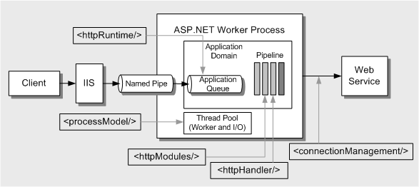
Monitoring and Tuning
ASP.NET Tuning
Most ASP.NET tuning is performed by modifying configuration parameters in the system - wide Machine.config file and the application-specific Web.config file. Architectural view of ASP.NET and its relationship to several key configuration elements located in Machine.config.

Slide 10
Monitoring and Tuning
ASP.NET Tuning
processModel
https://msdn.microsoft.com/en-us/library/7w2sway1(vs.71).aspx
httpRuntime
https://msdn.microsoft.com/en-in/library/ff647813.aspx#scalenetchapt17_topic14
ASP .Net monitoring
Worker Process
ASP.NET\Worker Process Restarts
Throughput
ASP.NET Applications\Requests/Sec
Web Service\ISAPI Extension Requests/sec
Requests: ASP.NET\ Requests Current
ASP.NET Applications\Requests Executing
ASP.NET Applications\ Requests Timed Out
Response time
ASP.NET\ Request Execution Time
Cache
ASP.NET Applications\ Cache Total Entries
ASP.NET Applications\ Cache Total Hit Ratio
ASP.NET Applications\Cache Total Turnover Rate

Slide 11
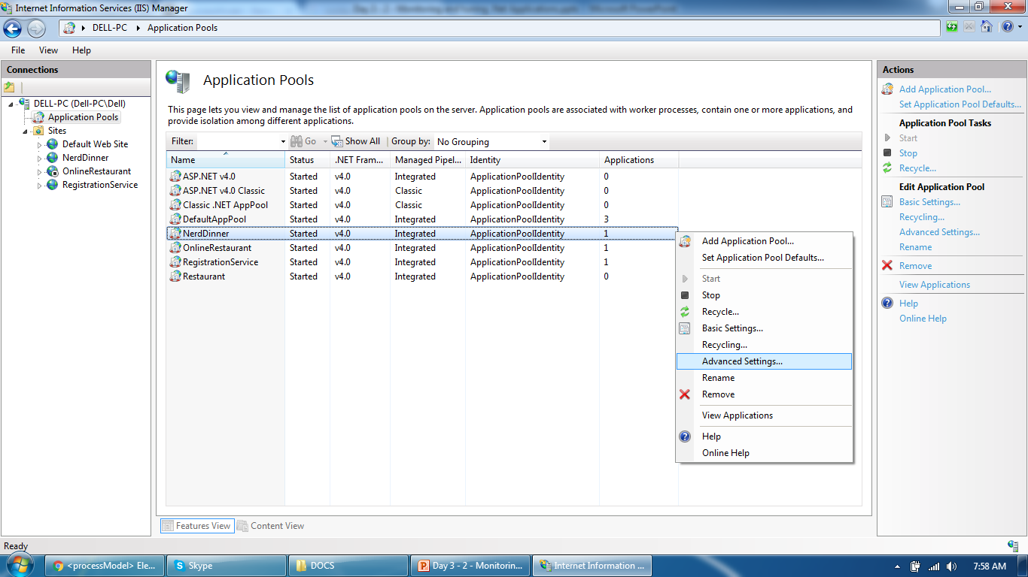
Monitoring and Tuning
ASP.Net tuning:
Advanced setting to check or overwrite the values

Slide 12
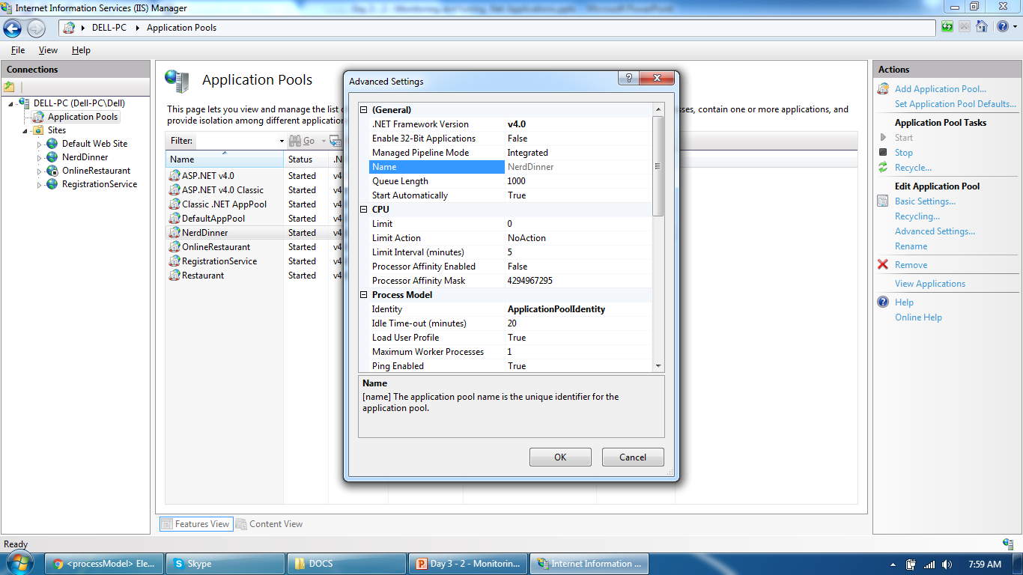
Monitoring and Tuning
ASP.Net tuning:
Advanced setting to check or overwrite the values

Slide 13
Monitoring and Tuning
References
Log parser: https://docs.microsoft.com/en-us/iis/troubleshoot/performance-issues/troubleshooting-iis-performance-issues-or-application-errors-using-logparser
Machine.config located at : C:\Windows\Microsoft.NET\Framework\v4.0.30319\Config
Web.config located at your application parent directory

Slide 14
Thank You

